Slide 1
Access Control
Access control is a fundamental component of data security that dictates who’s allowed to access and use company information and resources.
Through authentication and authorization, access control policies make sure users are who they say they are and that they have appropriate access to company data.
Access control can also be applied to limit physical access to campuses, buildings, rooms, and datacenters.

Slide 2
How does access control work?
Access control identifies users by verifying various login credentials, which can include usernames and passwords, PINs, biometric scans, and security tokens.
Many access control systems also include multifactor authentication (MFA), a method that requires multiple authentication methods to verify a user’s identity.
Once a user is authenticated, access control then authorizes the appropriate level of access and allowed actions associated with that user’s credentials and IP address.
There are four main types of access control. Organizations typically choose the method that makes the most sense based on their unique security and compliance requirements. The four access control models are:

Slide 3
Discretionary access control (DAC): In this method, the owner or administrator of the protected system, data, or resource sets the policies for who is allowed access.
Mandatory access control (MAC): In this nondiscretionary model, people are granted access based on an information clearance. A central authority regulates access rights based on different security levels. This model is common in government and military environments.
Role-based access control (RBAC): RBAC grants access based on defined business functions rather than the individual user’s identity. The goal is to provide users with access only to data that’s been deemed necessary for their roles within the organization. This widely used method is based on a complex combination of role assignments, authorizations, and permissions.
Attribute-based access control (ABAC): In this dynamic method, access is based on a set of attributes and environmental conditions, such as time of day and location, assigned to both users and resources.

Slide 4
Why is access control important?
Access control keeps confidential information such as customer data, personally identifiable information, and intellectual property from falling into the wrong hands.
It’s a key component of the modern zero trust security framework, which uses various mechanisms to continuously verify access to the company network.
Without robust access control policies, organizations risk data leakage from both internal and external sources.
Access control is particularly important for organizations with hybrid cloud and multi-cloud cloud environments, where resources, apps, and data reside both on premises and in the cloud.
Access control can provide these environments with more robust access security beyond single sign-on (SSO), and prevent unauthorized access from unmanaged and BYO devices.

Slide 5
Revocation of access rights
In a dynamic protection system, we may sometimes need to revoke access rights to objects shared by different users.
Various questions about revocation may arise:
Immediate versus delayed: Does revocation occur immediately, or is it delayed? If revocation is delayed, can we find out when it will take place?
Selective versus general: When an access right to an object is revoked, does it affect all the users who have an access right to that object, or can we specify a select group of users whose access rights should be revoked?
Partial versus total: Can a subset of the rights associated with an object be revoked, or must we revoke all access rights for this object?
Temporary versus permanent: Can access be revoked permanently (that is, the revoked access right will never again be available), or can access be revoked and later be obtained again?

Slide 6
With an access-list scheme, revocation is easy. The access list is searched for any access rights to be revoked, and they are deleted from the list.
Revocation is immediate and can be general or selective, total or partial, and permanent or temporary.
Capabilities, however, present a much more difficult revocation problem, as mentioned earlier.
Since the capabilities are distributed throughout the system, we must find them before we can revoke them.
Schemes that implement revocation for capabilities include the following:

Slide 7
Reacquisition:
Periodically, capabilities are deleted from each domain.
If a process wants to use a capability, it may find that that capability has been deleted.
The process may then try to reacquire the capability.
If access has been revoked, the process will not be able to reacquire the capability.
Back-pointers:
A list of pointers is maintained with each object, pointing to all capabilities associated with that object.
When revocation is required, we can follow these pointers, changing the capabilities as necessary.
This scheme was adopted in the MULTICS system.
It is quite general, but its implementation is costly.

Slide 8
Indirection:
The capabilities point indirectly, not directly, to the objects.
Each capability points to a unique entry in a global table, which in turn points to the object.
We implement revocation by searching the global table for the desired entry and deleting it.
Then, when an access is attempted, the capability is found to point to an illegal table entry.
Table entries can be reused for other capabilities without difficulty, since both the capability and the table entry contain the unique name of the object.
The object for a capability and its table entry must match.
This scheme was adopted in the CAL system. It does not allow selective revocation.

Slide 9
Keys
A key is a unique bit pattern that can be associated with a capability.
This key is defined when the capability is created, and it can be neither modified nor inspected by the process that owns the capability.
A master key is associated with each object; it can be defined or replaced with the set-key operation.
When a capability is created, the current value of the master key is associated with the capability.
When the capability is exercised, its key is compared with the master key.
If the keys match, the operation is allowed to continue; otherwise, an exception condition is raised.
Revocation replaces the master key with a new value via the set-key operation, invalidating all previous capabilities for this object.

Slide 10
Capability Based System
The concept of capability-based protection was introduced in the early 1970s.
Two early research systems were Hydra and CAP.
Neither system was widely used, but both provided interesting proving grounds for protection theories.
Here, we consider two more contemporary approaches to capabilities.

Slide 11
Linux Capabilities
Linux uses capabilities to address the limitations of the UNIX model, which we described earlier.
The POSIX standards group introduced capabilities in POSIX 1003.1e.
Although POSIX.1e was eventually withdrawn, Linux was quick to adopt capabilities in Version 2.2 and has continued to add new developments.
In essence, Linux’s capabilities “slice up” the powers of root into distinct areas, each represented by a bit in a bitmask, as shown in Figure 17.11. Fine grained control over privileged operations can be achieved by toggling bits in the bitmask.
In practice, three bitmasks are used—denoting the capabilities permitted, effective, and inheritable. Bitmasks can apply on a per-process or a per-thread basis.
Furthermore, once revoked, capabilities cannot be reacquired.

Slide 12
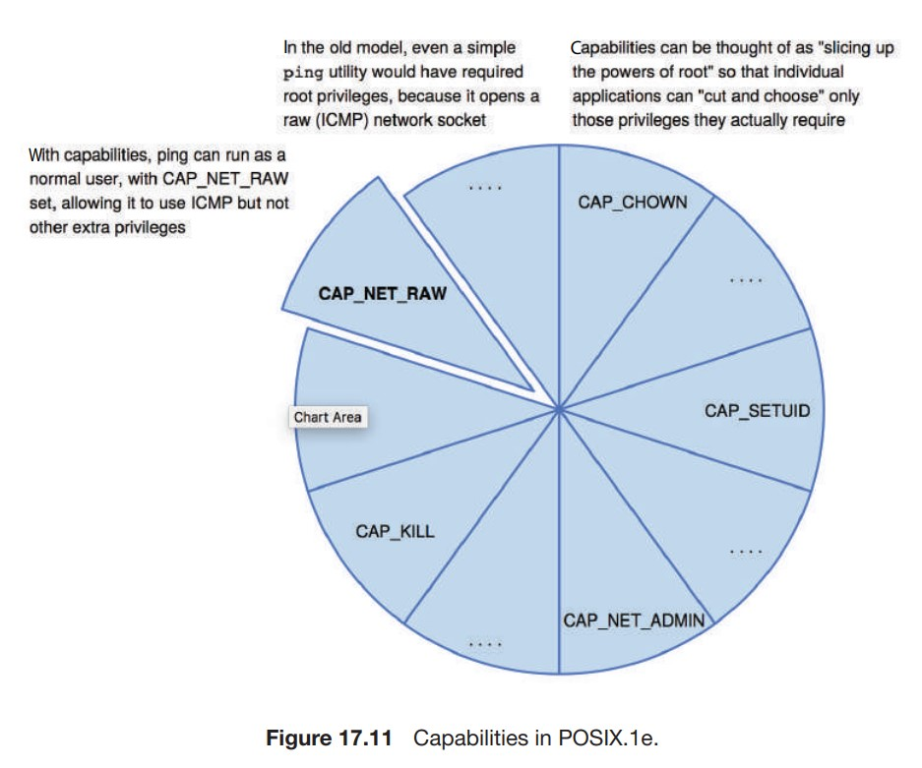

Slide 13
The usual sequence of events is that a process or thread starts with the full set of permitted capabilities and voluntarily decreases that set during execution.
For example, after opening a network port, a thread might remove that capability so that no further ports can be opened.
You can probably see that capabilities are a direct implementation of the principle of least privilege.
As explained earlier, this tenet of security dictates that an application or user must be given only those rights than are required for its normal operation.
Android (which is based on Linux) also utilizes capabilities, which enable system processes (notably, “system server”), to avoid root ownership, instead selectively enabling only those operations required. The

Slide 14
Linux capabilities model is a great improvement over the traditional UNIX model, but it still is inflexible.
For one thing, using a bitmap with a bit representing each capability makes it impossible to add capabilities dynamically and requires recompiling the kernel to add more.
In addition, the feature applies only to kernel-enforced capabilities.

